Slide 1

OMNI: Open-endedness via Models of human Notions of Interestingness
Jenny Zhang, Joel Lehman, Kenneth Stanley, Jeff Clune

Slide 2
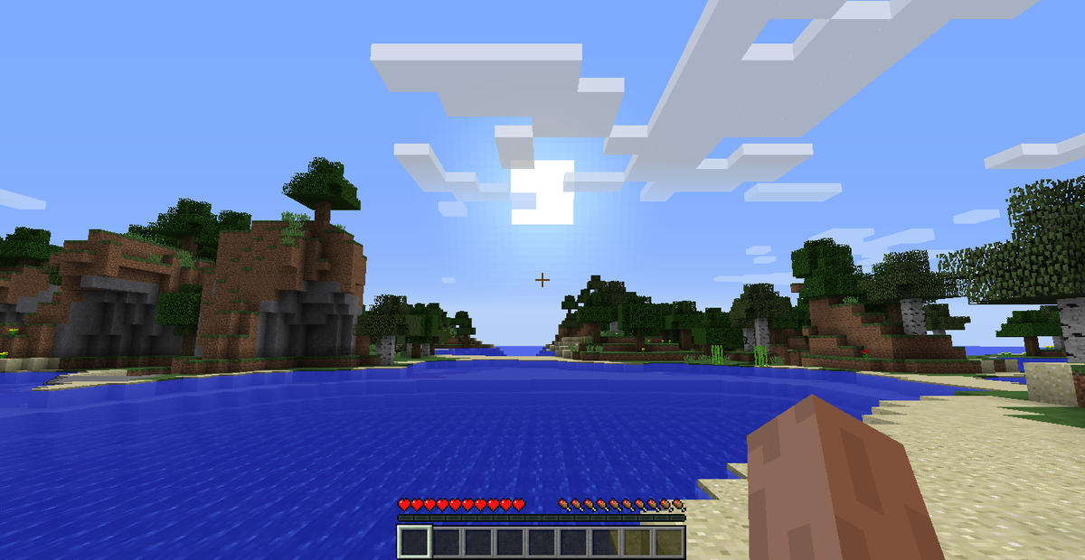
Training Reinforcement Learning (RL) Agents in Large Environments
Large environment → Large search space
→ Infinitely many possible tasks
Even when we only count tasks that the agent is able to learn
How do we choose which tasks to learn first?
Large Language Models (LLMs) contain human knowledge
Humans know which tasks are interesting
→ An LLM could tell an RL agent which tasks to learn first
FIGURE 1 Minecraft – an example of an extremely large environment, with an infinitely large action space. Mojang 2011, Minecraft. Screenshot from https://minecraft.fandom.com/wiki/Gameplay

Slide 3
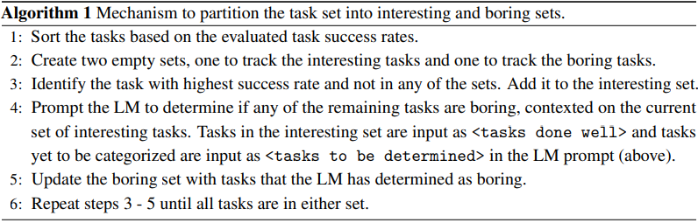
Method
You are a player in a game. You want to learn as many skills as possible.
You can do these tasks well: <tasks done well>.
Suggest whether the given tasks are interesting: <tasks to be determined>.
PROMPT
ALGORITHM
FIGURE 2 Algorithm as presented in [1].

Slide 4
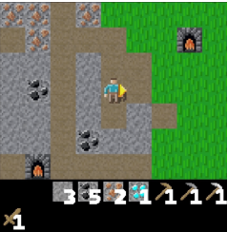
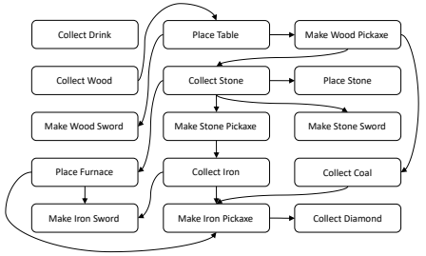
Usage in Practice
Algorithm tested in Crafter
RL agent trained using Proximal Policy Optimization (PPO)
State-of-the-art «standard» RL method
OMNI’s role: Suggest tasks for agent to perform
Interesting tasks will be chosen more often
Influences policy of RL agent (choosing an action)
«Boring» tasks were added to show LLM’s decision-making ability
FIGURE 3 Above: Danijar Hafner 2021, Crafter. Screenshot from [1]. Below: Example of actions considered interesting, and the order in which they should be completed.

Slide 5
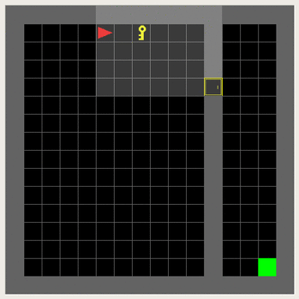
Relevance to Our Project
We also want to choose relevant actions
Generalized algorithm
It may be used even in different environments
Other ways of using LLMs also possible
For reward shaping, instead of policy
Interpretation of «interestingness»
Interesting = action with highest success rate?
Interesting = action most similar to other interesting actions?
OMNI algorithm assumes the two above
Interesting = (performed) action most similar to goal?
FIGURE 4 Minigrid, the testing environment we use in our project [2]. Screenshot from https://minigrid.farama.org/

Slide 6
References
[1] J. Zhang et al., «OMNI: Open-endedness via Models of human Notions of Interestingness». https://arxiv.org/abs/2306.01711
[2] M. Chevalier-Boisvert et al., «Minigrid & Miniworld: Modular & Customizable Reinforcement Learning Environments for Goal-Oriented Tasks». https://arxiv.org/abs/2306.13831

